Slide 1


COMP 5048
Flight Data Visualisation
Group 30:
Nagib Shah | (470360839)
Xinan Ma | (470489934)
Alan Shen | (470194809)
Young Choi | (470346338)
Qiushi Zhang | (470119101)
Girishkumar Dhotarkar | (470351620)

Slide 2

01
Introduction
The flight(delay) dataset contains largely US domestic flights network consisting of approximately 120 million flights arrival and departure informationfrom the years 1987 till 2008. Dataset primary have 3 different entities
ONTIME (Arrival/departure & delay reasons transactions data)
AIRPORTS (Airport master data)
CARRIERS (Airline master Data)
Dataset
Build Visualization(s) system for flight (delay) dataset to answer following:
Visualise overview airline networks in US causing delay in flight network
Visualise best time of year for travelling with minimal flight delays
Visualise performance of airports and carrier year on year
Visualise negative effect of specific incident or event on flight delay
Give traveling guide to hitchhikers based on visualization analysis
Aim
COMP5048 Group 30

Slide 3
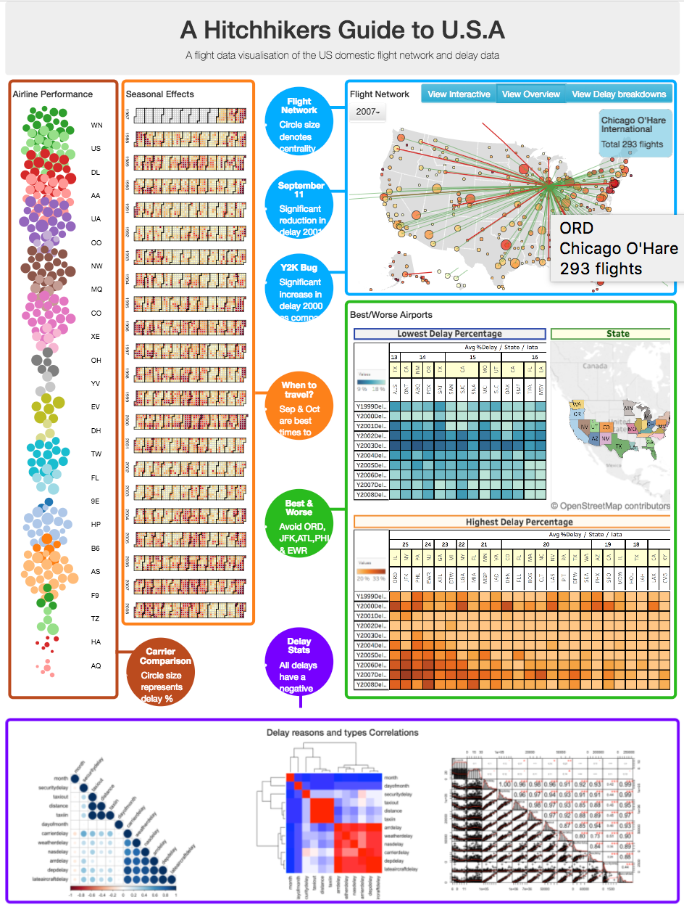
Design
-Visualization System
02
Visualisation | Layout | Tool / Software
Flight Network | Geo-spatial Layout | NetworkX ARCGIS
Seasonal Effects | Calendar Layout | D3
Airline Performance | Bubble Chart Layout | D3
Airport Performance | Map Layout | Tableau
Statistical Analysis | Correlation Matrix | R
COMP5048 Group 30
Group 30

Slide 4
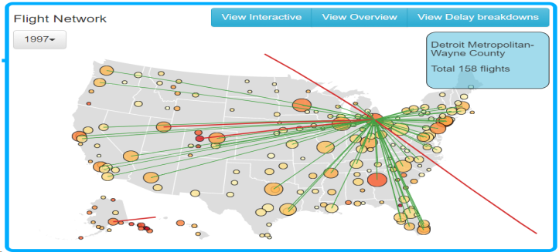
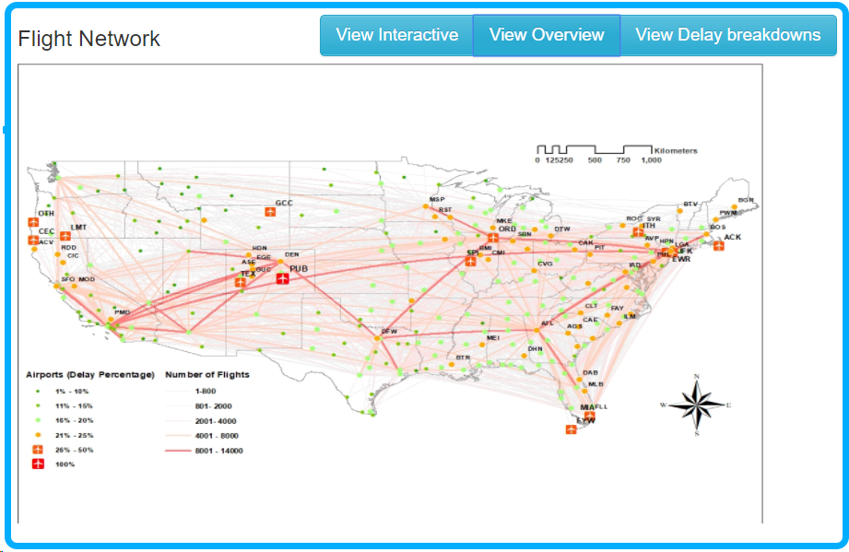
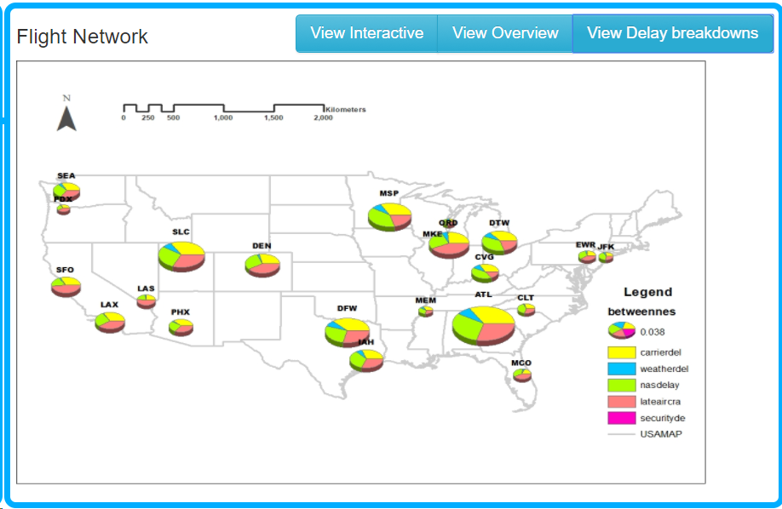
Design-Flight Network
02
Analysis Technique / Algorithm Used
K-core
Betweenness centrality
COMP5048 Group 30

Slide 5
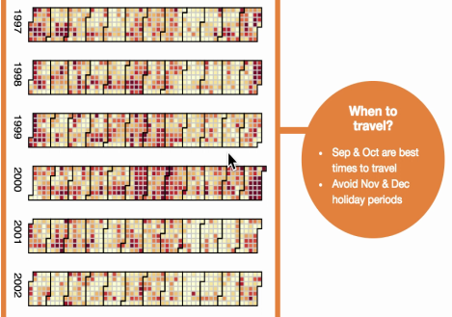
Design-Seasonal Effect
02
Analysis Technique / Algorithm Used
Heat map
COMP5048 Group 30

Slide 6
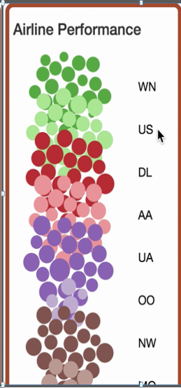
Design-Airline Performance
02
Analysis Technique / Algorithm Used
Force Directed algorithm
COMP5048 Group 30

Slide 7
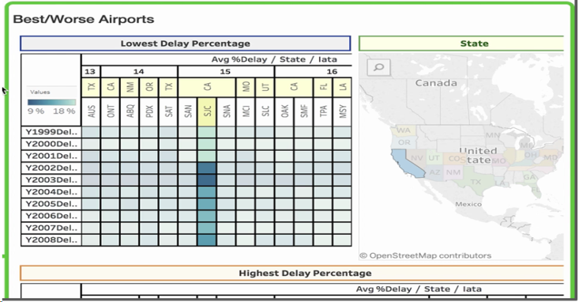
Design-Airports Performance
02
Analysis Technique / Algorithm Used
Statistical analysis
COMP5048 Group 30

Slide 8
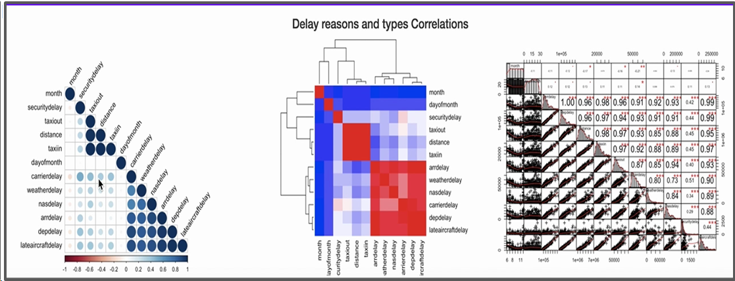
Design-Statistical Analysis
02
Analysis Technique / Algorithm Used
Correlation Matrix
COMP5048 Group 30

Slide 9

03
Implementation
Deliver VA System & Final Report
Evaluate visualisation & Presentation
Build & Integrate visualisation system
Peer review and Prepare Initial report
Design, Develop code or use software tools to visualise and perform QA
Develop & test queries for each visualisation
Cleanse data and Create Indexes
Extract & Load of data
COMP5048 Group 30

Slide 10
04
Evaluation
Data/ Visualisation | Task(s) | Evaluationn framework/ Methods | Pros/ Cons Analysis
Primary Interactive Flight Network | Identify critical routes Identify critical airports/nodes Summary of overall network | Peer Review Feedback from focus group (questionnaire) Cross validation utilising past references | Identify and document pros/cons and limitations
COMP5048 Group 30

Slide 11

05
Progress
Project Status:
Green (Ahead of Schedule)
Release VA system & Final Report
02/Nov/17
Submission
Report 1
Kick-Off
Presentation
15/Sep/17
28/Sep/17
12/Sep/17
Sep/2017
15 Sep-21 Sep
22 Sep- 28 Sep
29 Sep-05 Oct
06 Oct-12 Oct
13 Oct-19 Oct
20 Oct-26 Oct
27 Oct-02 Nov
Nov/2017
Data Set Selection
Design Completed
Development Completed
Evaluation Complete
Final Report
100%
20%
VA Design
& Report 1
100%
Flight Network
95%
Seasonal Effect
95%
Development & Unit Testing
Airline Performance
95%
Airport Performance
95%
Correlation Matrix
95%
Integration Of VA System & Presentation PPT
95%
Evaluation
40%
15%
Documentation Final Report
0%
100%
COMP5048 Group 30

Slide 12
06
Planning
COMP5048 Group 30

Slide 13
GROUP 30
THANK YOU

